Slide 1
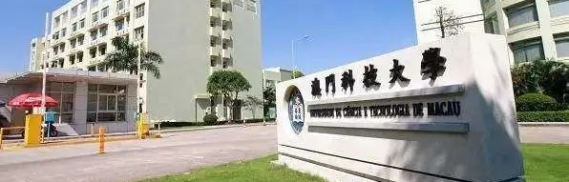

Research on the Structure of Offline Handwritten Signature Verification Models based on Transformer
Master of Science in Intelligent Technology Thesis Oral Defense
Speaker：Mingchen Wang Student No.: 2230025907 Supervisor：Xin Liu
Date：2025.05.19

Slide 2
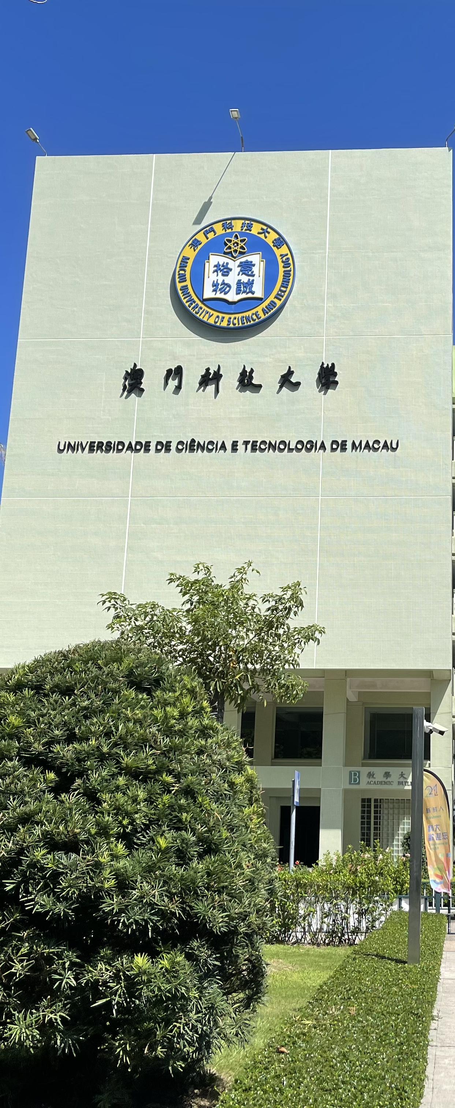

CONTENTS
意| 誠| 格| 物
01
Introduction
04
Experiments
02
Related Work
05
Conclusions
03
Methodology

Slide 3
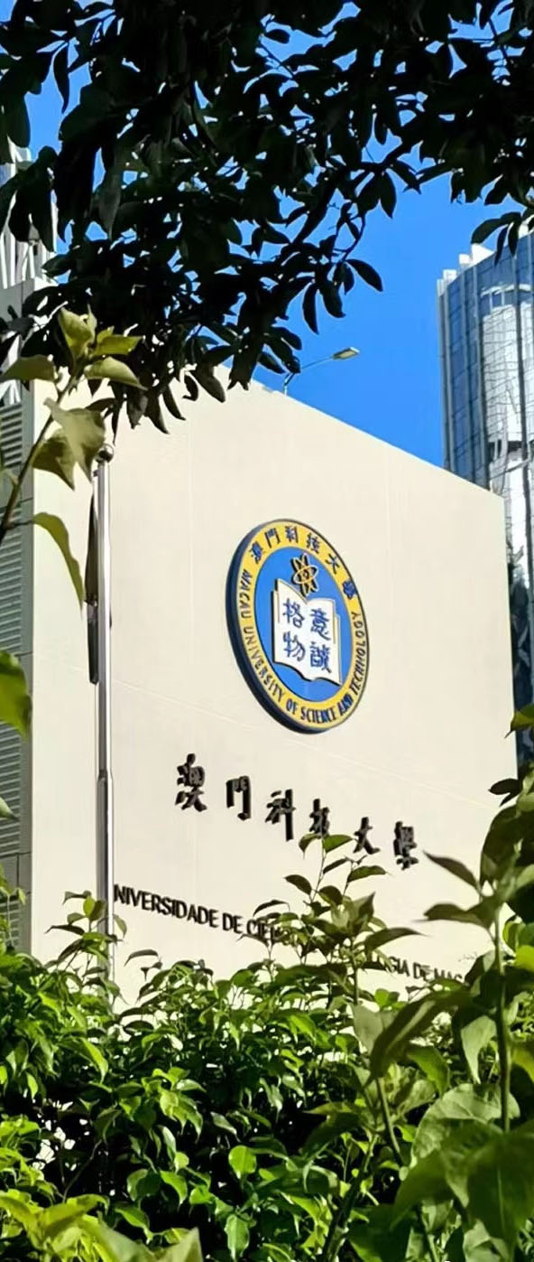

Chapter 1
Introduction
Background & Motivation

Slide 4

Introduction
Related Work
Methodology
Experiments
Conclusions
1.1 Research Background
Biometrcis Technology
Identify or verify personal identity based on the user's fingerprints, iris, signature and other physiological characteristics.
Offline & Online
Two types of signature verification: online and offline. Offline using only the handwritten signature image.
Application Areas
Widely used in security fields such as security authentication and financial transactions.
Handwritten signature verification is a personal identity verification application of biometric technology
[12] Offline handwritten signature verification—Literature review

Slide 5


Introduction
Related Work
Methodology
Experiments
Conclusions
1.2 Research Motivation
Limit of traditional methods
Advantages of Deep Learning
Strongly dependent feature extraction engineering.
Poor generalization ability, need to be fine-tuned for each scene.
CNN is not good at modeling long-range dependencies.
End-to-end learning reduces manual intervention.
Global attention mechanism captures signature spatial relationships.
More in line with the accuracy requirements of actual production applications
[4, 9, 11, 12, 36, 41]

Slide 6
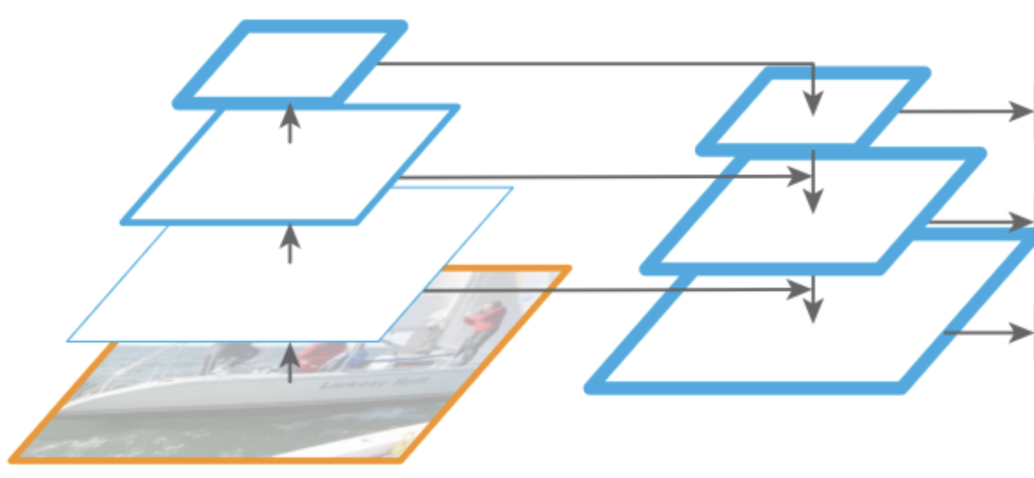
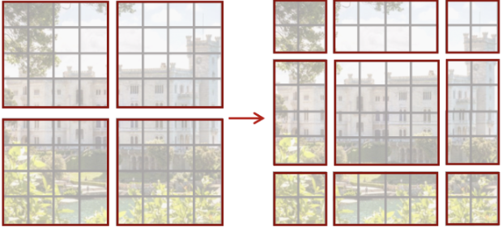

Introduction
Related Work
Methodology
Experiments
Conclusions
1.3 Research Objects & Innovation
01
02
03
Mult-scale
Swin Transformer
Optimize Module
For cross-dataset and large size, a pair of multi-scale features of signature images are added to the model.
Adding a sliding window to the ViT allows the model to automatically capture local information of the image.
Optimize some submodules in the multi-scale feature model to better utilize multi scale feature information.
[13, 23]

Slide 7

Chapter 2
Related Work
Literature Review

Slide 8
Introduction
Related Work
Methodology
Experiments
Conclusions
2.1 Literature Review
Machine Learning
HMM
SVM
Random forest
Transformer
Vision Transformer (2021)
TransOSV (2024)
HTCSigNet (2025)
1990s
2000s
2015
2020
Future
Traditional Methodology
Geometric feature
LBP、HOG feature
Dynamic time warping (DTW)
Deep Learning
CNN & SVM
Siamese CNN (SigNet)
Hybrid CNN-LSTM
Multimodal (Trend)
Multimodal fusion
Adversarial defense
Lightweight deployment
[3, 4, 10, 11, 14, 17, 19, 20, 25, 32, 33, 34, 35, 39, 40, 41]

Slide 9
Chapter 3
Methodology
OSV Modeling

Slide 10
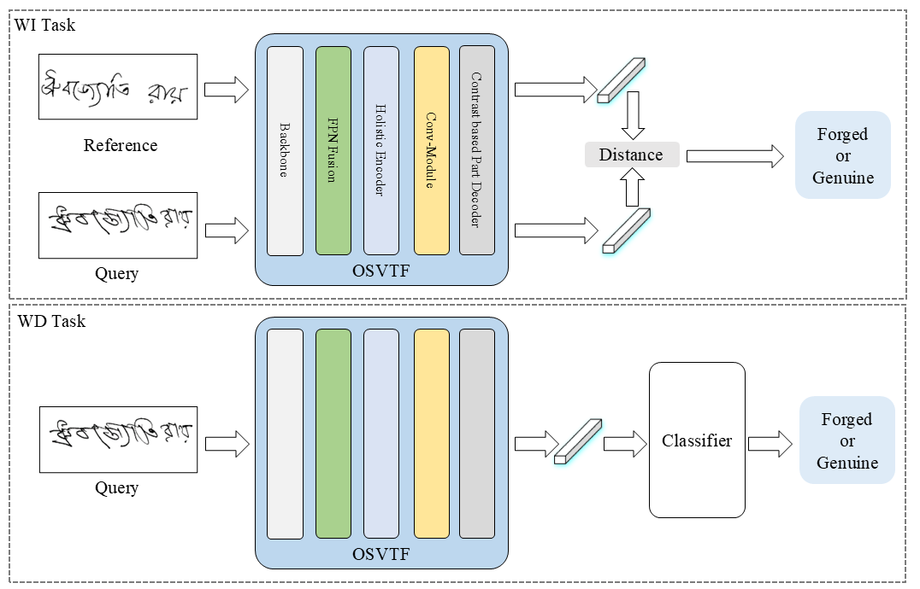
Introduction
Related Work
Methodology
Experiments
Conclusions
3.1 Overview

Slide 11
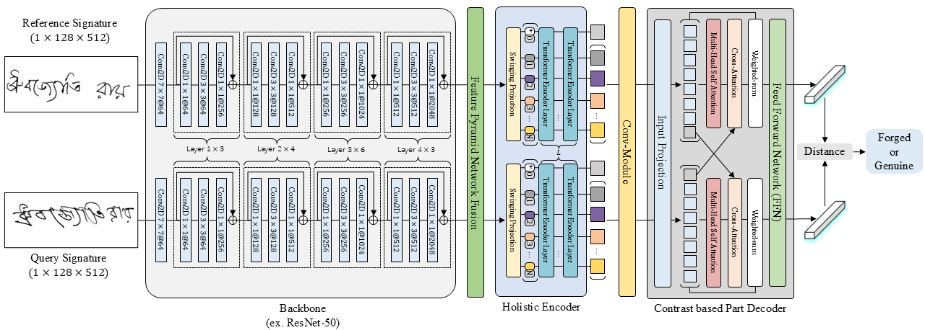
Introduction
Related Work
Methodology
Experiments
Conclusions
3.1 Overview
Offline Signature Verification TransFormer (OSVTF)

Slide 12
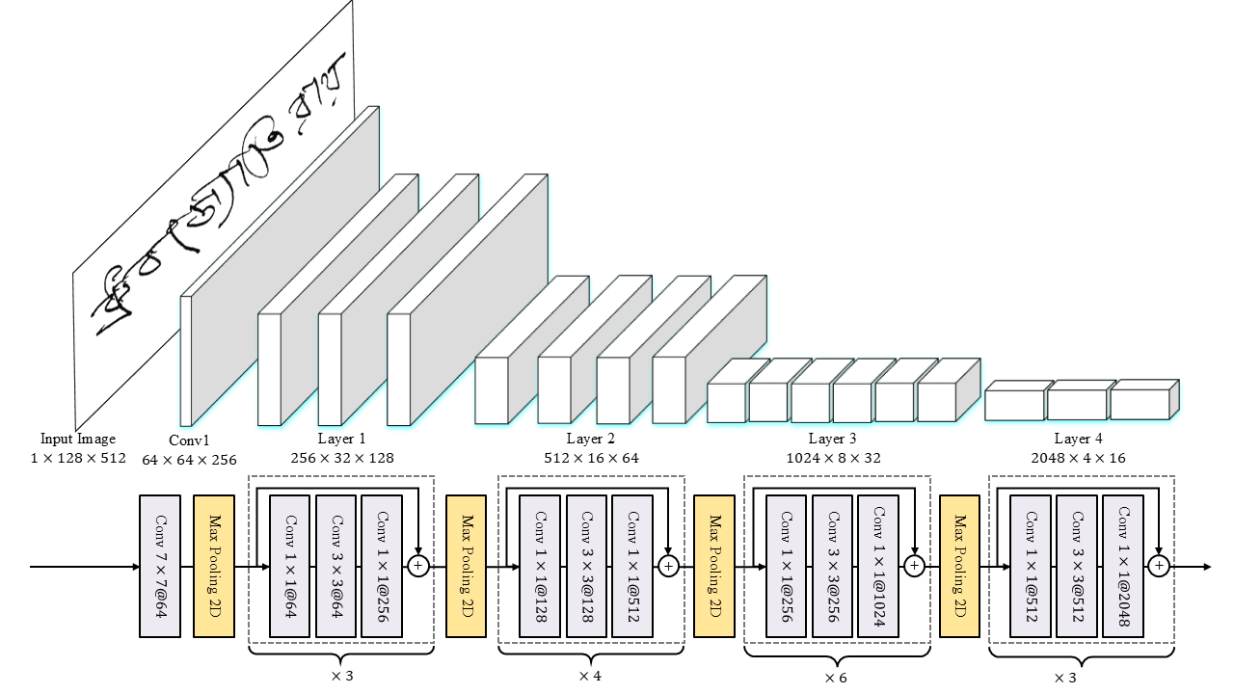
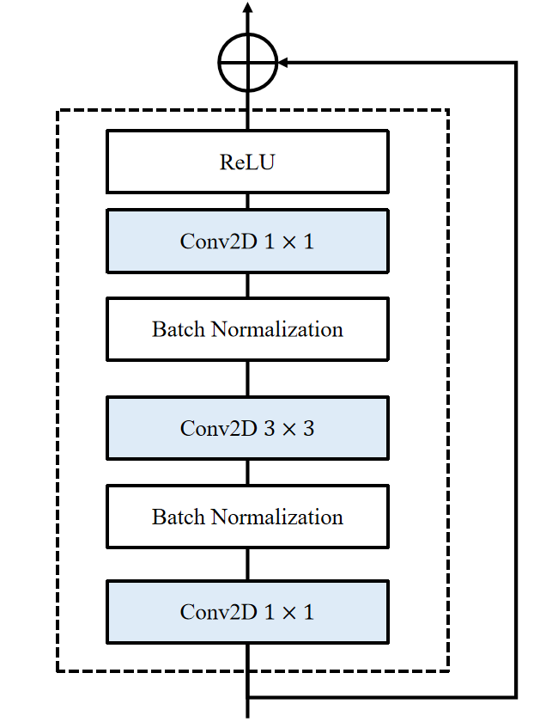

Introduction
Related Work
Methodology
Experiments
Conclusions
3.2 Backbone $\left(ℬ\right)$
ResNet-50
Bottleneck Block
[14] Deep Residual Learning for Image Recognition

Slide 13
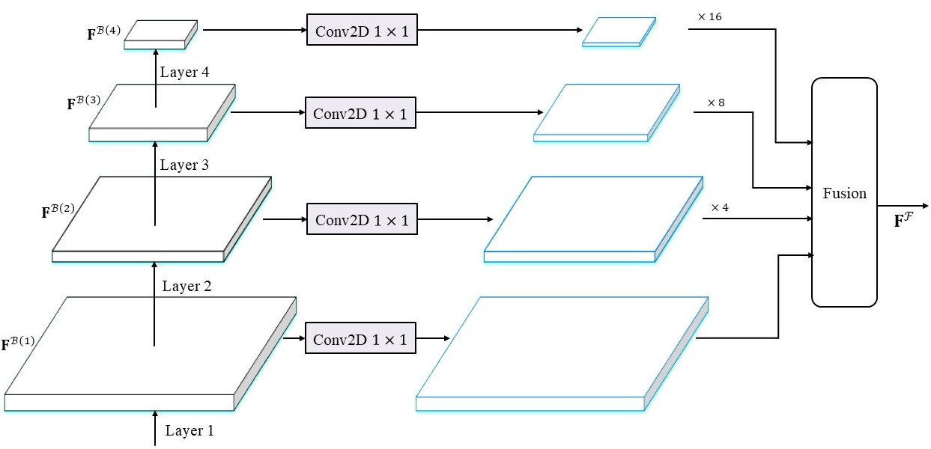
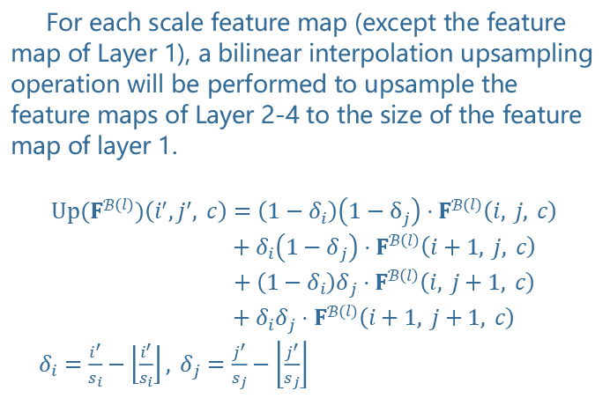
Introduction
Related Work
Methodology
Experiments
Conclusions
3.3 FPN Fusion Module $\left(ℱ\right)$
For each scale feature map (except the feature map of Layer 1), a bilinear interpolation upsampling operation will be performed to upsample the feature maps of Layer 2-4 to the size of the feature map of layer 1.
$$Up(F^{ℬ\left(l\right)})\left(i^{′},j^{′}, c\right)=\left(1−δ_{i}\right)\left(1−δ_{j}\right)⋅F^{ℬ\left(l\right)}\left(i, j, c\right)$$
$$+δ_{i}\left(1−δ_{j}\right)⋅F^{ℬ\left(l\right)}\left(i+1, j, c\right)$$
$$+\left(1−δ_{i}\right)δ_{j}⋅F^{ℬ\left(l\right)}\left(i, j+1, c\right)$$
$$+δ_{i}δ_{j}⋅F^{ℬ\left(l\right)}\left(i+1, j+1, c\right)$$
$δ_{i}=\frac{i^{′}}{s_{i}}−\left\lfloor \frac{i^{′}}{s_{i}}\right\rfloor , δ_{j}=\frac{j^{′}}{s_{j}}−\left\lfloor \frac{j^{′}}{s_{j}}\right\rfloor$
[23] Feature Pyramid Networks for Object Detection

Slide 14
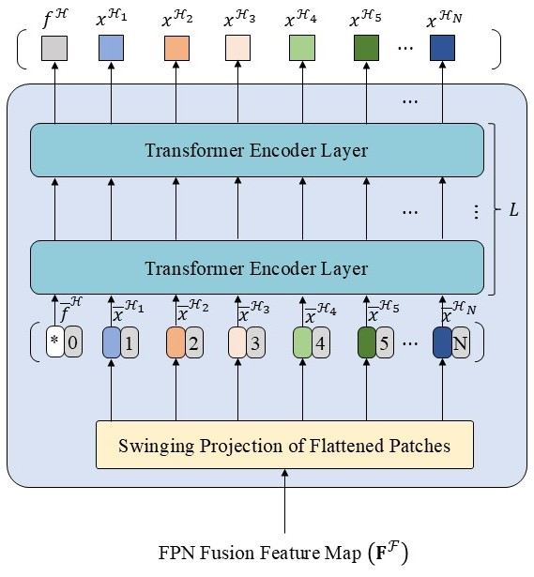
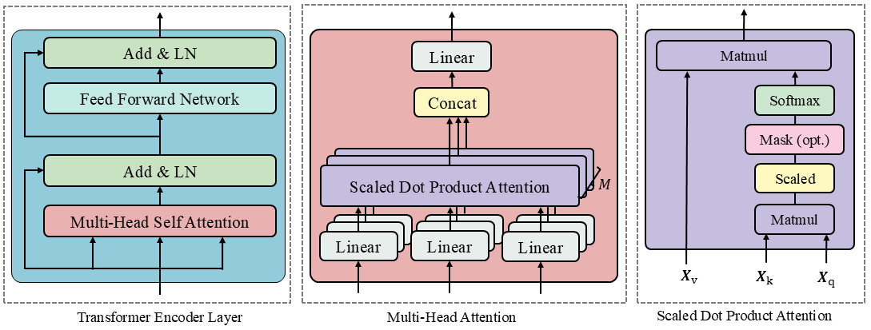
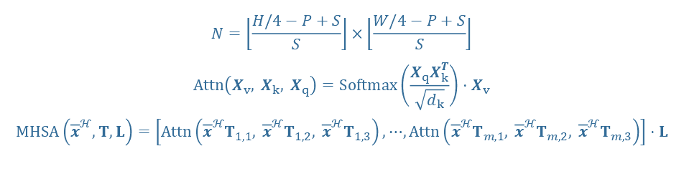
Introduction
Related Work
Methodology
Experiments
Conclusions
3.4 Holistic Encoder $\left(ℋ\right)$
$$N=\left\lfloor \frac{H/4−P+S}{S}\right\rfloor ×\left\lfloor \frac{W/4−P+S}{S}\right\rfloor$$
$$Attn\left(X_{v}, X_{k}, X_{q}\right)=Softmax\left(\frac{X_{q}X_{k}^{T}}{\sqrt{d_{k}}}\right)⋅X_{v}$$
$$MHSA\left({\overline{x}}^{ℋ},T,L\right)=\left[Attn\left({\overline{x}}^{ℋ}T_{1,1}, {\overline{x}}^{ℋ}T_{1,2}, {\overline{x}}^{ℋ}T_{1,3}\right),⋯,Attn\left({\overline{x}}^{ℋ}T_{m,1}, {\overline{x}}^{ℋ}T_{m,2}, {\overline{x}}^{ℋ}T_{m,3}\right)\right]⋅L$$
Holistic Encoder Structure
Multi-Head Self Attention
[4] An Image is Worth 16x16 Words: Transformers for Image Recognition at Scale

Slide 15
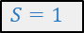

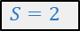
Introduction
Related Work
Methodology
Experiments
Conclusions
3.4 Holistic Encoder $\left(ℋ\right)$
$$P=3$$
$$S=1$$
$$S=2$$
[24] Swin Transformer: Hierarchical Vision Transformer using Shifted Windows

Slide 16
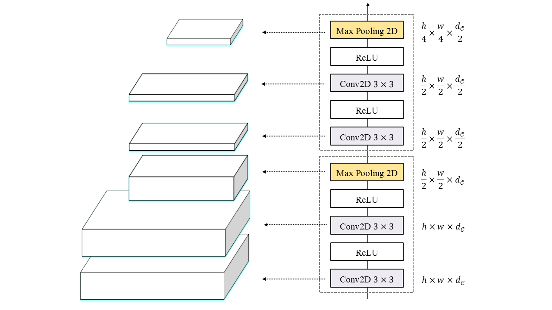
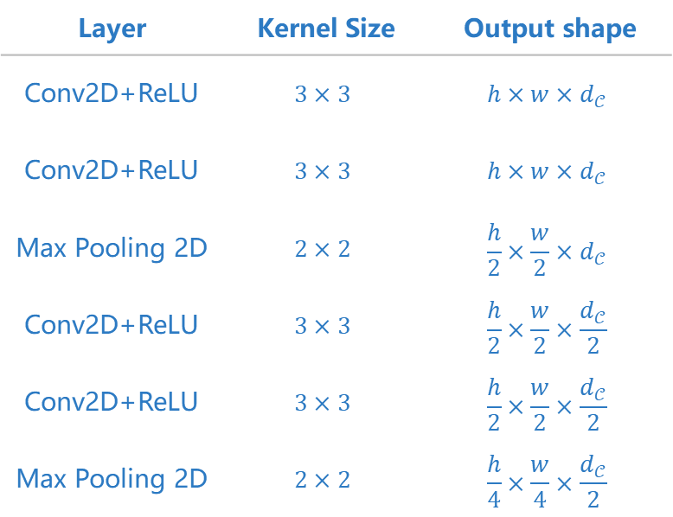
Introduction
Related Work
Methodology
Experiments
Conclusions
3.5 Conv-Module $\left(𝒞\right)$
Layer | Kernel Size | Output shape
Conv2D+ReLU | $$3×3$$ | $$h×w×d_{𝒞}$$
Conv2D+ReLU | $$3×3$$ | $$h×w×d_{𝒞}$$
Max Pooling 2D | $$2×2$$ | $$\frac{h}{2}×\frac{w}{2}×d_{𝒞}$$
Conv2D+ReLU | $$3×3$$ | $$\frac{h}{2}×\frac{w}{2}×\frac{d_{𝒞}}{2}$$
Conv2D+ReLU | $$3×3$$ | $$\frac{h}{2}×\frac{w}{2}×\frac{d_{𝒞}}{2}$$
Max Pooling 2D | $$2×2$$ | $$\frac{h}{4}×\frac{w}{4}×\frac{d_{𝒞}}{2}$$
[41] HTCSigNet: A Hybrid Transformer and Convolution Signature Network for offline signature verification

Slide 17
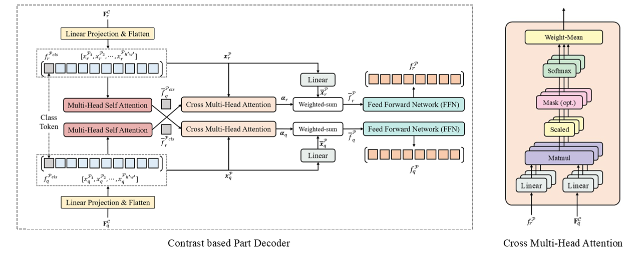
Introduction
Related Work
Methodology
Experiments
Conclusions
3.6 Contrast based Part Decoder $\left(𝒫\right)$
[41] TransOSV: Offline Signature Verification with Transformers

Slide 18
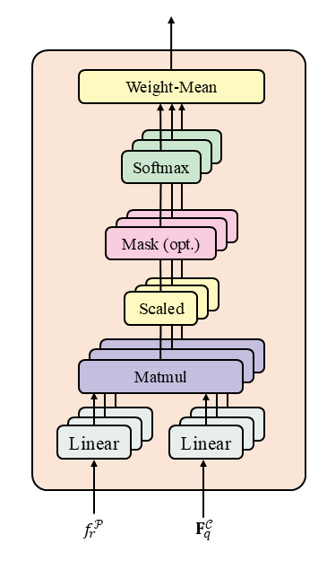
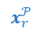
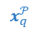
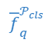
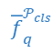
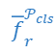
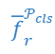
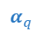
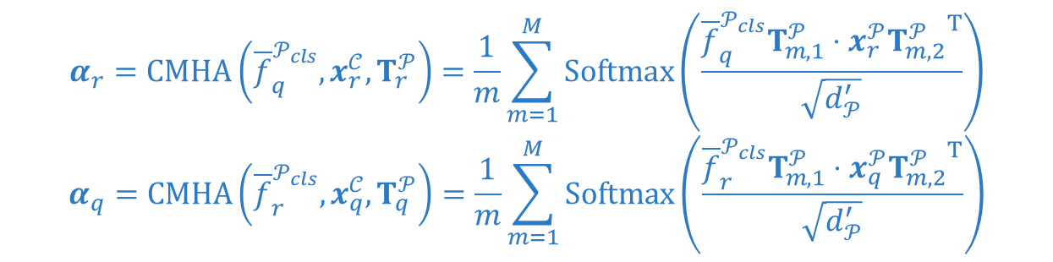
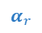
Introduction
Related Work
Methodology
Experiments
Conclusions
3.7 Cross Multi-Head Attention
$${\overline{f}}_{r}^{𝒫_{cls}}$$
$$x_{r}^{𝒫}$$
$${\overline{f}}_{q}^{𝒫_{cls}}$$
$$x_{r}^{𝒫}$$
Cross Multi-Head Attention
$$α_{r}$$
Multi-Head Self Attention
Multi-Head Self Attention
Cross Multi-Head Attention
$$α_{q}$$
$${\overline{f}}_{r}^{𝒫_{cls}}$$
$$x_{q}^{𝒫}$$
$${\overline{f}}_{q}^{𝒫_{cls}}$$
$$x_{q}^{𝒫}$$
$$α_{r}=CMHA\left({\overline{f}}_{q}^{𝒫_{cls}}, x_{r}^{𝒞}, T_{r}^{𝒫}\right)=\frac{1}{m}\sum_{m=1}^{M}{Softmax\left(\frac{{\overline{f}}_{q}^{𝒫_{cls}}T_{m, 1}^{𝒫}⋅x_{r}^{𝒫}{T_{m, 2}^{𝒫}}^{T}}{\sqrt{d_{𝒫}^{′}}}\right)}$$
$$α_{q}=CMHA\left({\overline{f}}_{r}^{𝒫_{cls}}, x_{q}^{𝒞}, T_{q}^{𝒫}\right)=\frac{1}{m}\sum_{m=1}^{M}{Softmax\left(\frac{{\overline{f}}_{r}^{𝒫_{cls}}T_{m, 1}^{𝒫}⋅x_{q}^{𝒫}{T_{m, 2}^{𝒫}}^{T}}{\sqrt{d_{𝒫}^{′}}}\right)}$$
[41] TransOSV: Offline Signature Verification with Transformers

Slide 19
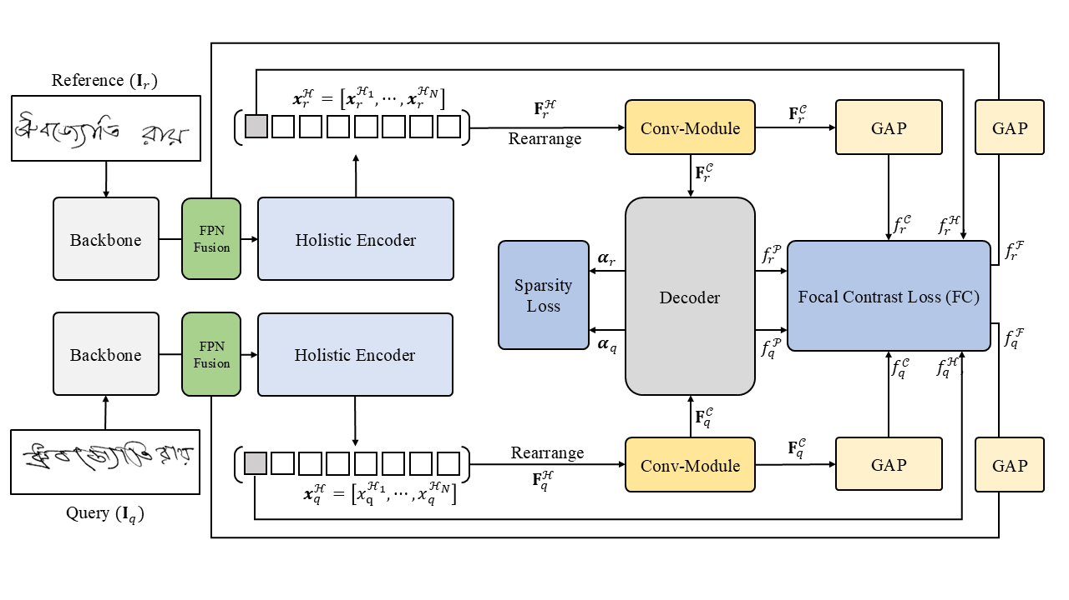
Introduction
Related Work
Methodology
Experiments
Conclusions
3.11 Loss Function

Slide 20
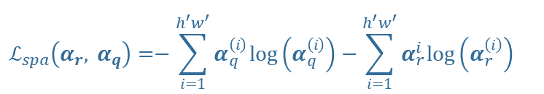
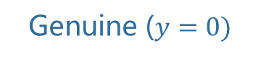
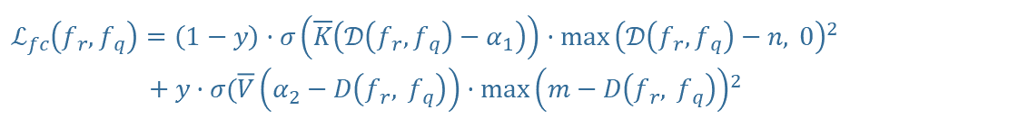
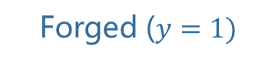
Introduction
Related Work
Methodology
Experiments
Conclusions
3.11 Loss Function
Train Loss
$$ℒ=\left[λ_{1}, λ_{2},λ_{3}, λ_{4}\right]⋅{\left[ℒ_{fc}\left(f_{r}^{ℱ}, f_{q}^{ℱ}\right),ℒ_{fc}\left(f_{r}^{ℋ}, f_{q}^{ℋ}\right),ℒ_{fc}\left(f_{r}^{𝒞}, f_{q}^{𝒞}\right),ℒ_{fc}\left(f_{r}^{𝒫}, f_{q}^{𝒫}\right)\right]}^{T}+ξℒ_{spa}\left(α_{r}, α_{q}\right)$$
01. Focal Contrast Loss
$$ℒ_{fc}\left(f_{r},f_{q}\right)=\left(1−y\right)⋅σ\left(\overline{K}\left(𝒟\left(f_{r},f_{q}\right)−α_{1}\right)\right)⋅{\max\left(𝒟\left(f_{r},f_{q}\right)−n, 0\right)}^{2}$$
$$+y⋅σ(\overline{V}\left(α_{2}−D\left(f_{r}, f_{q}\right)\right)⋅{\max\left(m−D\left(f_{r}, f_{q}\right)\right)}^{2}$$
Genuine ($y=0)$
02. Sparsity Loss (spa)
$$ℒ_{spa}\left(α_{r}, α_{q}\right)=−\sum_{i=1}^{h^{′}w^{′}}{α_{q}^{\left(i\right)}\log\left(α_{q}^{\left(i\right)}\right)−\sum_{i=1}^{h^{′}w^{′}}{α_{r}^{i}\log\left(α_{r}^{\left(i\right)}\right)} }$$
Forged ($y=1)$
[41] TransOSV: Offline Signature Verification with Transformers

Slide 21
Chapter 4
Experiments
Results analysis

Slide 22

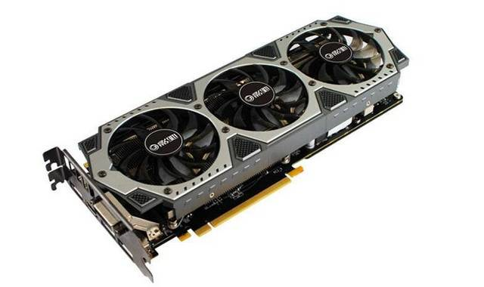
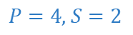
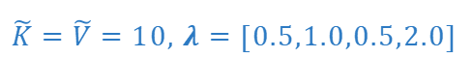
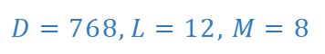
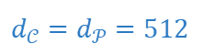
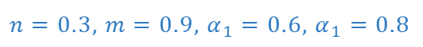
Introduction
Related Work
Methodology
Experiments
Conclusions
4.1 Experimental Setup
NVIDIA RTX 3080 10GB*2
$$D=768,L=12, M=8$$
$$P=4, S=2$$
$$d_{𝒞}=d_{𝒫}=512$$
$$n=0.3, m=0.9, α_{1}=0.6, α_{1}=0.8$$
$$\tilde{K}=\tilde{V}=10, λ=[0.5,1.0,0.5,2.0]$$

Slide 23
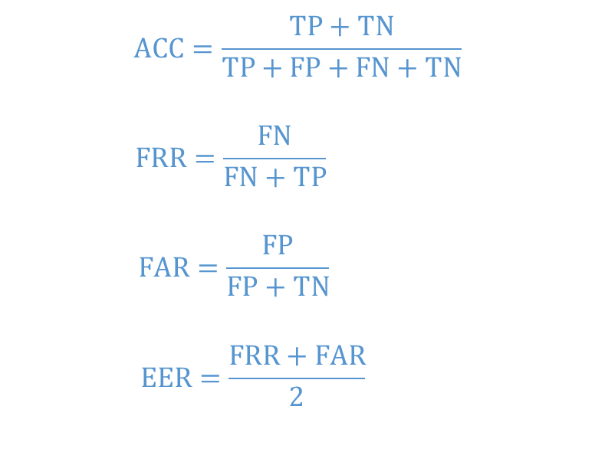

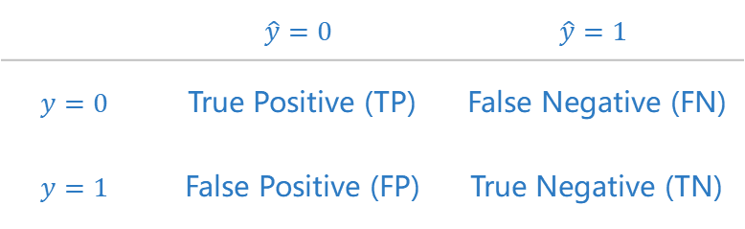

Introduction
Related Work
Methodology
Experiments
Conclusions
4.2 Metrics
Genuine ($y=0)$
$$ACC=\frac{TP+TN}{TP+FP+FN+TN}$$
$$FRR=\frac{FN}{FN+TP}$$
$$FAR=\frac{FP}{FP+TN}$$
$$EER=\frac{FRR+FAR}{2}$$
Forged ($y=1)$
Table 4.1: Confusion matrix
 | $$\hat{y}=0$$ | $$\hat{y}=1$$
$$y=0$$ | True Positive (TP) | False Negative (FN)
$$y=1$$ | False Positive (FP) | True Negative (TN)
[6] An Introduction to ROC Analysis
[7] Offline Geometric Parameters for Automatic Signature Verification Using Fixed-Point Arithmetic

Slide 24
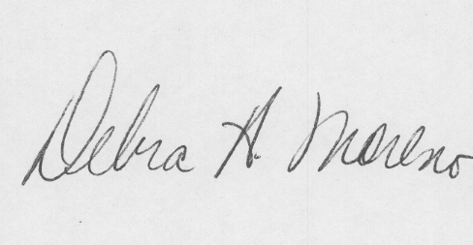
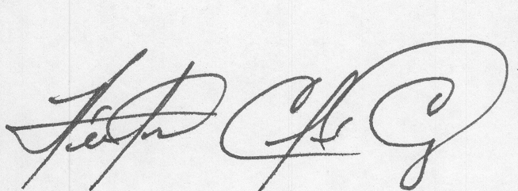
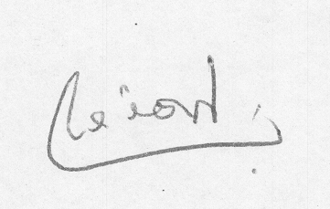
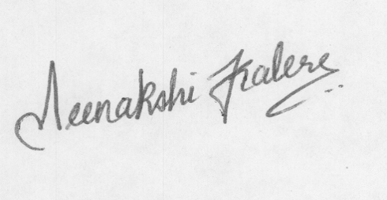
Introduction
Related Work
Methodology
Experiments
Conclusions
4.3 Dataset
BHSig-B (100) & BHSig-H (160)
CEDAR (55)
24 genuine & 30 forged
276 positive samples & 720 negative samples
24 genuine & 24 forged
276 positive samples & 576 negative samples
[3, 30]

Slide 25
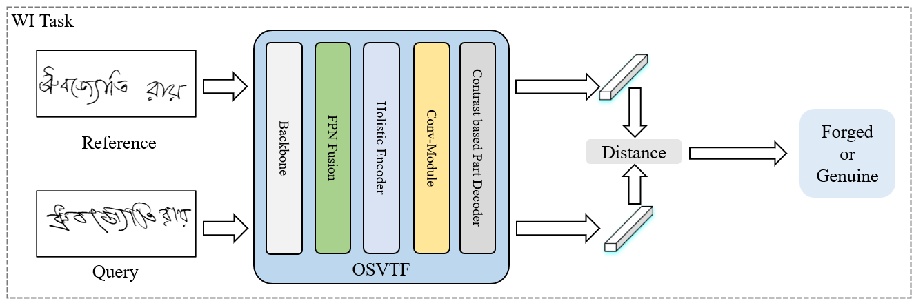
Introduction
Related Work
Methodology
Experiments
Conclusions
4.4 Writer-Independent Results
Table 4.2: BHSig-B WI task performance
Table 4.3: BHSig-H WI task performance
Model | FRR | FAR | EER
BHSig-B 50/50
SigNet [30] | 13.89 | 13.89 | 13.89
CaP [25] | 3.96 | 3.96 | 3.96
IDN [37] | 5.24 | 4.12 | -
InceptionSVGNet [27] | 2.22 | 3.88 | -
TransOSV [41] | 9.90 (12.41) | 9.90 (12.41) | 9.90 (12.41)
OSVTF [Ours] | 10.72 | 10.85 | 10.79
BHSig-B 80/20
DeepHsv[21] | 11.92 | 11.92 | 11.92
TransOSV | 3.56 (5.11) | 3.56 (5.11) | 3.56 (5.11)
OSVTF [Ours] | 4.47 | 4.61 | 4.54
Model | FRR | FAR | EER
BHSig-H 100/60
SigNet [32] | 15.36 | 15.36 | 15.36
IDN [38] | 4.93 | 8.99 | -
CaP [24] | 5.97 | 5.97 | 5.97
InceptionSVGNet [27] | 3.33 | 6.38 | -
TransOSV [41] | 3.24 (4.86) | 3.24 (4.86) | 3.24 (4.86)
OSVTF [Ours] | 3.86 | 3.94 | 3.90

Slide 26
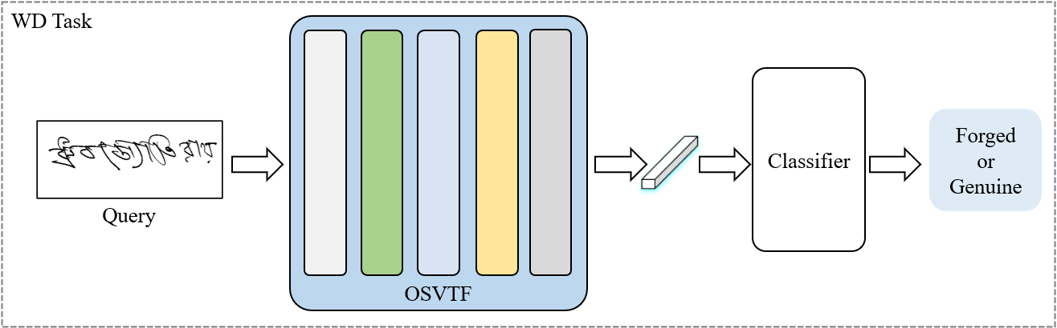
Introduction
Related Work
Methodology
Experiments
Conclusions
4.5 Writer-Dependent Results
Table 4.4: BHSig dataset WD task performance
Model | FRR | FAR | EER
BHSig-B 80/20
TransOSV [Ours] | 3.78 | 3.78 | 3.78
OSVTF [SVM] | 2.74 | 2.80 | 2.77
OVSTF [GAP] | 2.05 | 2.21 | 2.13
BHSig-H 100/60
TransOSV [Ours] | 4.23 | 4.23 | 4.23
OSVTF [SVM] | 3.17 | 3.21 | 3.19
OVSTF [GAP] | 2.67 | 2.69 | 2.68
For WD task, OSVTF use the classifier composed of SVM or Global Average Pooling (GAP) + Fully Connection for offline signature verification.
During the training process, Hinge loss is used for SVM and Cross-entropy loss is used for GAP.

Slide 27
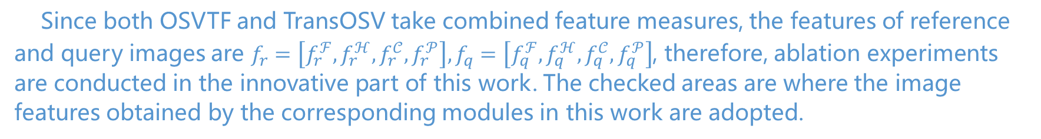
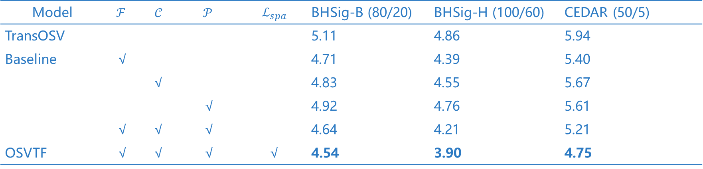
Introduction
Related Work
Methodology
Experiments
Conclusions
4.6 Ablation Experiments
Table 4.5: WI task EER results of ablation experiments
Model | $$ℱ$$ | $𝒞$ | $$𝒫$$ | $$ℒ_{spa}$$ | BHSig-B (80/20) | BHSig-H (100/60) | CEDAR (50/5)
TransOSV |  |  |  |  | 5.11 | 4.86 | 5.94
Baseline | √ |  |  |  | 4.71 | 4.39 | 5.40
 |  | √ |  |  | 4.83 | 4.55 | 5.67
 |  |  | √ |  | 4.92 | 4.76 | 5.61
 | √ | √ | √ |  | 4.64 | 4.21 | 5.21
OSVTF | √ | √ | √ | √ | 4.54 | 3.90 | 4.75
Since both OSVTF and TransOSV take combined feature measures, the features of reference and query images are $f_{r}=\left[f_{r}^{ℱ}, f_{r}^{ℋ}, f_{r}^{𝒞},f_{r}^{𝒫}\right],f_{q}=\left[f_{q}^{ℱ}, f_{q}^{ℋ}, f_{q}^{𝒞},f_{q}^{𝒫}\right]$, therefore, ablation experiments are conducted in the innovative part of this work. The checked areas are where the image features obtained by the corresponding modules in this work are adopted.

Slide 28

Introduction
Related Work
Methodology
Experiments
Conclusions
4.6 Ablation Experiments

Slide 29


Introduction
Related Work
Methodology
Experiments
Conclusions
4.6 Ablation Experiments

Slide 30


Introduction
Related Work
Methodology
Experiments
Conclusions
4.6 Ablation Experiments

Slide 31
Chapter 5
Conclusions
Conclusions & Further Work

Slide 32
Introduction
Related Work
Methodology
Experiments
Conclusions
5.1 Conclusions
WI task performance
01. Multi-Scale Fusion Feature
Under the same environment, the performance of OSVTF is improved compared with TransOSV, which proves that the multi-scale fusion features of images can improve the image feature learning ability to a certain extent based on the combined features.
02. Performance Improvements
On the WI task, OSVTF performs about 17% better than TransOSV. However, it is still far behind HTCSigNet.

Slide 33
Introduction
Related Work
Methodology
Experiments
Conclusions
5.1 Conclusions
15.01%
24.62%
36.46%
33.44%
12.56%
WI BHSig-B
WI BHSig-H
WD BHSig-B
WD BHSig-H
50/50, 80/20
100/60
80/20
100/60

Slide 34

Introduction
Related Work
Methodology
Experiments
Conclusions
5.2 Further Work
01
03
Experimental limitations
2D Attention Mechanism
Due to the limited number of GPU devices, it is impossible to reproduce the performance of recent models 100%, so the actual performance of OSVTF should be better.
In 2017, the attention mechanism of Transformer was applied to flat features, and the image should be calculated in 2D dimension.
02
04
Backbone Optimization
Forged Attention
In the backbone link, the more mini ResNet-18 and ResNet-34 were used for experiments, and the image size was set to be small.
The experimental part should focus on the details of forged signatures.

Slide 35
Thank you for watching and looking forward to your review
Speaker: Mingchen Wang Student No.: 2230025907 Supervisor: Xin Liu
Date: 2025.05.19

Slide 36

Q&A Model Params
Table: TransOSV params
Encoder Layer | FLOPs / G | Params / M | EER
$$L=4$$ | 18.94 | 52.56 | 6.19
$$L=6$$ | 26.06 | 66.74 | 4.36
$$L=8$$ | 33.18 | 80.91 | 3.24
$$L=10$$ | 40.30 | 95.09 | 5.54
Table: OSVTF params
Backbone | FLOPs / G | Params / M | Memory / GB
ResNet-18 | 36.18 | 83.40 | 1.234
ResNet-34 | 38.32 | 93.51 | 1.416
ResNet-50 | 39.18 | 96.47 | 1.549

Slide 37

Q&A CNN and SVM for Signature Verification
[11] Learning features for offline handwritten signature verification using deep convolutional neural networks

Slide 38


Q&A Transformer for Signature Verification
[41] TransOSV: Offline Signature Verification with Transformers

Slide 39

Q&A Transformer for Signature Verification
HTCSigNet: A Hybrid Transformer and Convolution Signature Network for offline signature verification

Slide 40


Q&A Transformer for Signature Verification
HTCSigNet: A Hybrid Transformer and Convolution Signature Network for offline signature verification

Slide 41



Q&A Feed Forward Network (FFN)
Introducing nonlinear transformation (nonlinear modeling capability)
Improving feature dimension (projecting to high dimension and then compressing)
Independent modeling by position (local transformation)
Improving model capacity in representation learning
$$FFN(x)=\operatorname{GeLU}\left(xW_{1}+b_{1}\right)W_{2}+b_{2}$$
Linear
$$W_{2}, b_{2}$$
Dropout
GeLU
Linear
$$W_{1}, b_{1}$$
[8]

Slide 42



Q&A ReLU & GeLU Activation Function
ReLU is widely used in CNN for image classification and recognition. Most mobile and embedded systems use ReLU because of its faster calculation speed.
GeLU has a probability of retaining some negative values ​​and has a smoother nonlinear mapping. It is better to use it with Layer Normalization. The disadvantage is that it requires a lot of calculation.
$$ReLU\left(x\right)=\max\left(0, x\right) \\ GeLU\left(x\right)=\frac{1}{2}x\left(1+erf\left(\frac{x}{\sqrt{2}}\right)\right)≈\frac{1}{2}x\left(1+tanh \left[\sqrt{\frac{2}{ π}}\left(x+0.044715x^{3}\right)\right]\right) \\ erf\left(x\right)=\frac{2}{\sqrt{π}}\int_{0}^{x}{e^{−t^{2}}dt}$$
[15] Gaussian Error Linear Units [29] Rectified Linear Units Improve Restricted Boltzmann Machines

Slide 43







Q&A Batch & Layer Normalization
$$N$$
$$N$$
$$BS$$
$$BS$$
$$C$$
$$C$$
$$μ=\frac{1}{BS}\sum_{bs}^{BS}{z(bs, i, j,c)}$$
$$σ^{2}=\frac{1}{BS}\sum_{bs}^{BS}{{\left(z\left(bs, i, j, c\right)−μ\right)}^{2}}$$
$$\hat{z}\left(i, j, c\right)=γ\frac{z\left(i,j,c\right)−μ}{\sqrt{σ^{2}+ε}}+β$$
$$μ=\frac{1}{C}\sum_{c=1}^{C}{z(i, j,c)}$$
$$σ^{2}=\frac{1}{C}\sum_{c=1}^{C}{{\left(z\left(i, j, c\right)−μ\right)}^{2}}$$
$$\hat{z}\left(i, j, c\right)=γ\frac{z\left(i,j,c\right)−μ}{\sqrt{σ^{2}+ε}}+β$$
Batch Normalization (BN)
Layer Normalization (LN)
[1, 16]

